Slide 1
COLLEGE MANAGEMENT SYSTEM
WILL BE PRESENTED BY:
ABDUL RAFAY CT-012
MAHSHID FATIMA CT-023
NASHRA GHAFFAR CT-032
MEHAK HUSSAIN CT-030

Slide 2
introduction

Slide 3
PURPOSE
Automation of admission and enrolment.
Assistance in decision making.
To manage information of student, faculty and courses.
Consistently update information of all students.

Slide 4
FUNCTIONAL REQUIREMENTS
Log in Module (LM)
Administrator Module (AM)
Server Module (SM)
Normal Users Module (NUM)

Slide 5
NON-FUNCTIONAL REQUIREMENTS
Performance
Security
Maintainability
Availability
Portability

Slide 6
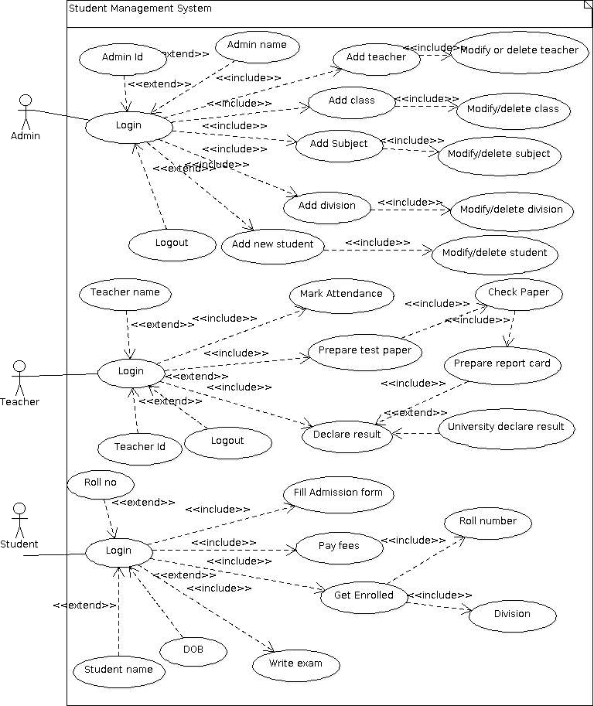
USE CASE

Slide 7
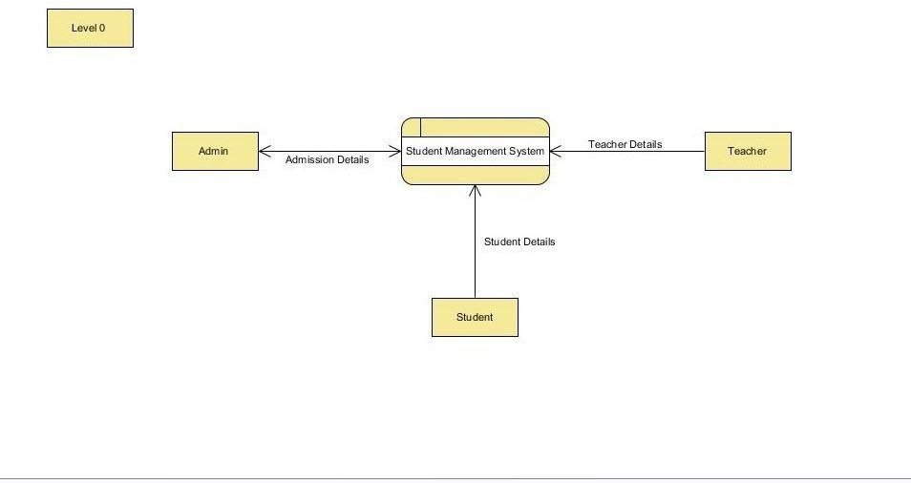
DATA FLOW DIAGRAM

Slide 8
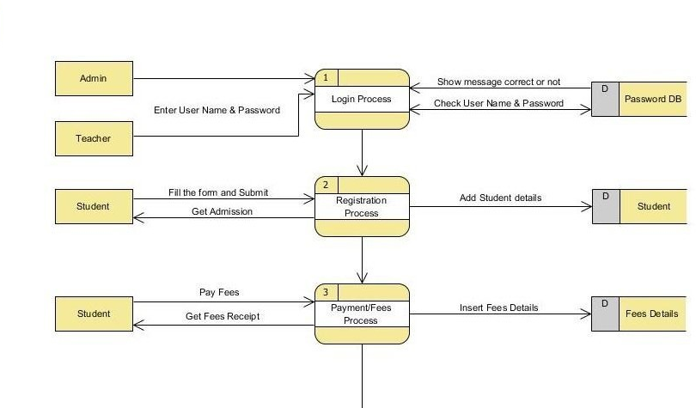
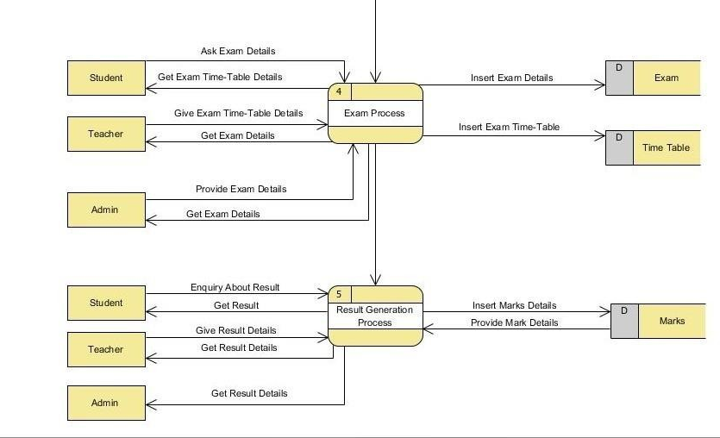
DATA FLOW DIAGRAM

Slide 9
DATA FLOW DIAGRAM

Slide 10
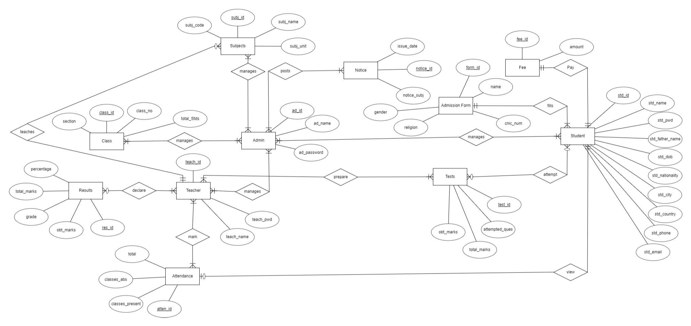
ER-DIAGRAM (LOGICAL)

Slide 11
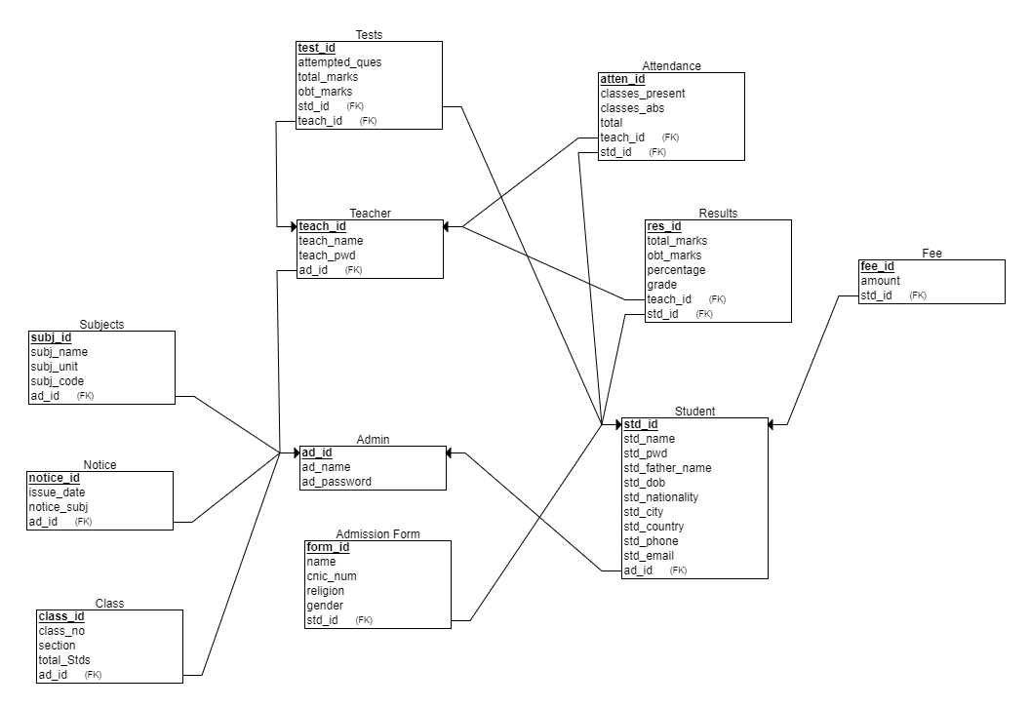
ER-DIAGRAM (PHYSICAL)

Slide 12
GENERAL CONSTRAINTS
Domain Integrity Constraint
Entity Integrity Constraint
Tuple Uniqueness Constraint
Referential Integrity Constraint

Slide 13
Our database

